Slide 1

Smart India Hackathon 2020 (Software)
Team - Trojans301
PS – SB109
Sagar Mahajan (Team Leader)
Shripad Kulkarni
Harshad Dabhade
Aditya Giradkar
Katha Patel
Abhijit Gawai
Dr. Vijay Mane (Mentor)

Slide 2


IT Solutions for precision based irrigation, fertigation, crop
growth, crop maturity in Horticulture.
Problem Statement: SB109

Slide 3
Problems Faced by Farmers
Farmers are not that much literate so they mostly try to avoid more technical facilities.
For farming farmers need many instruments but due to poor financial condition they can’t afford that.
2.
4.
Government launches many schemes for the farmers but they can’t take advantage of that because they simply don’t know anything about it.
They don’t have enough knowledge about diseases on plant and fertilizes.
1.
3.

Slide 4






Approche / Solution
IRRIGATION
OPEN FORUM
SELL & BUY
SCHEMES
CHATBOT
DISEASE DETECTION

Slide 5
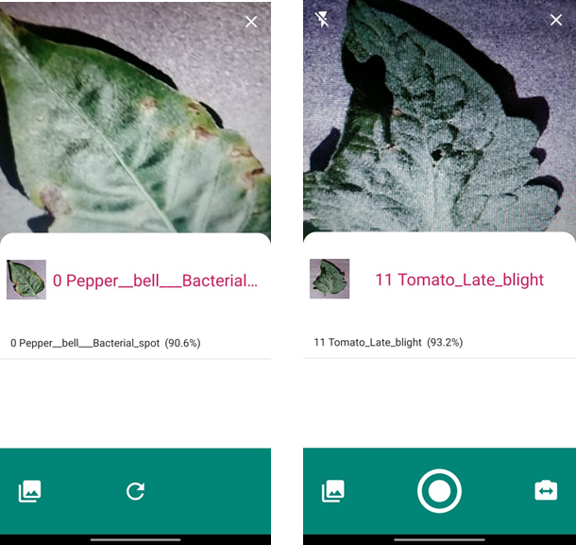
Disease Detection Offline
Offline Available
Currently 12 diseases are been detect.
Image can be selected from gallery or from camera.
Successfully detected

Slide 6
Horticulture plant data
Infected Data
Machine Learning Algorithm
Disease Detection
Solution / Fertilizer
Combination of Infected and Healthy plant Dataset.
Data sorting. Categorize data according disease.
Deep Learning CNN algorithm use. With Google’s Teachable Machine
Capture the image or upload the testing image in Android App for detection.
Suggesting cure for particular diseased.
1
2
3
4
5

Slide 7
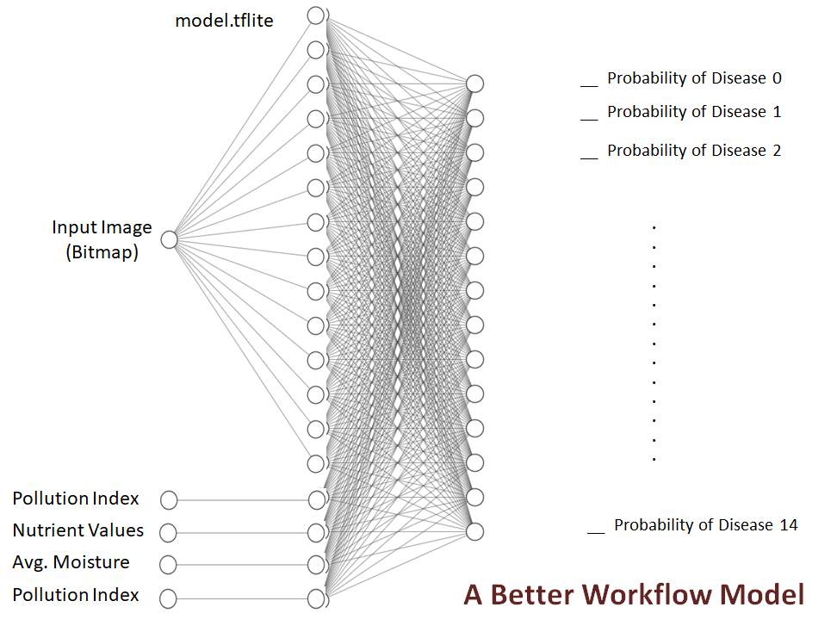
Disease Detection Algorithm
Peast

Slide 8
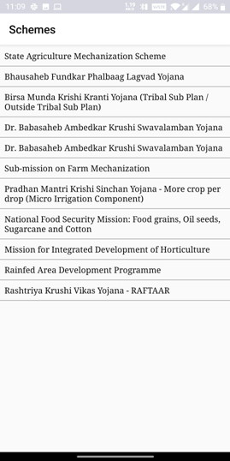
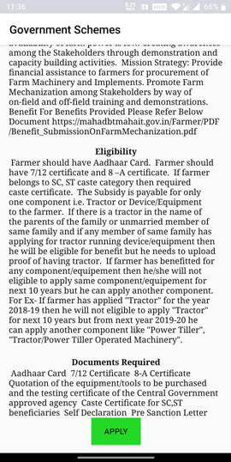


Government Schemes
With just one CLICK go to Authentic Government Site Link

Slide 9
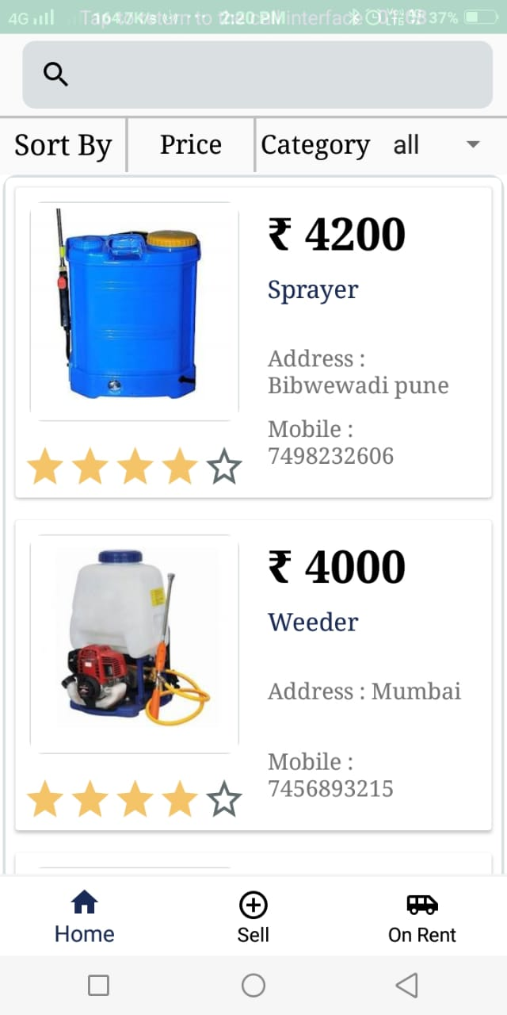
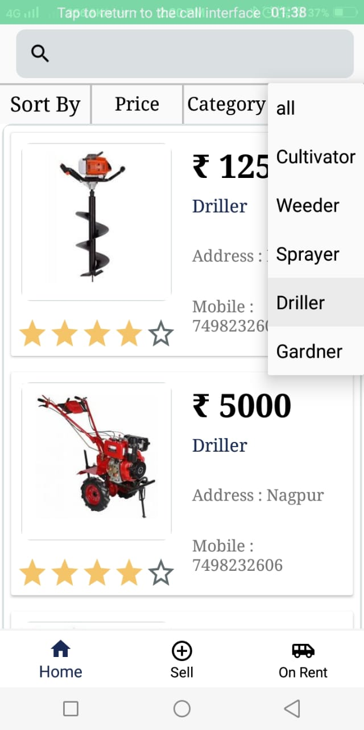
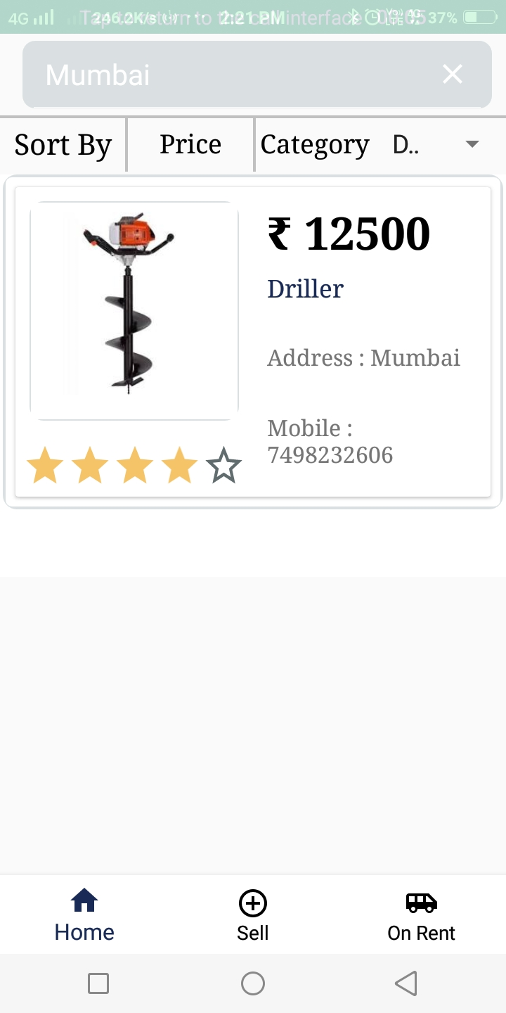
Sell, Buy & Rent
Rental Product available
Place for Buying and Selling their Goods.
User - User interaction

Slide 10
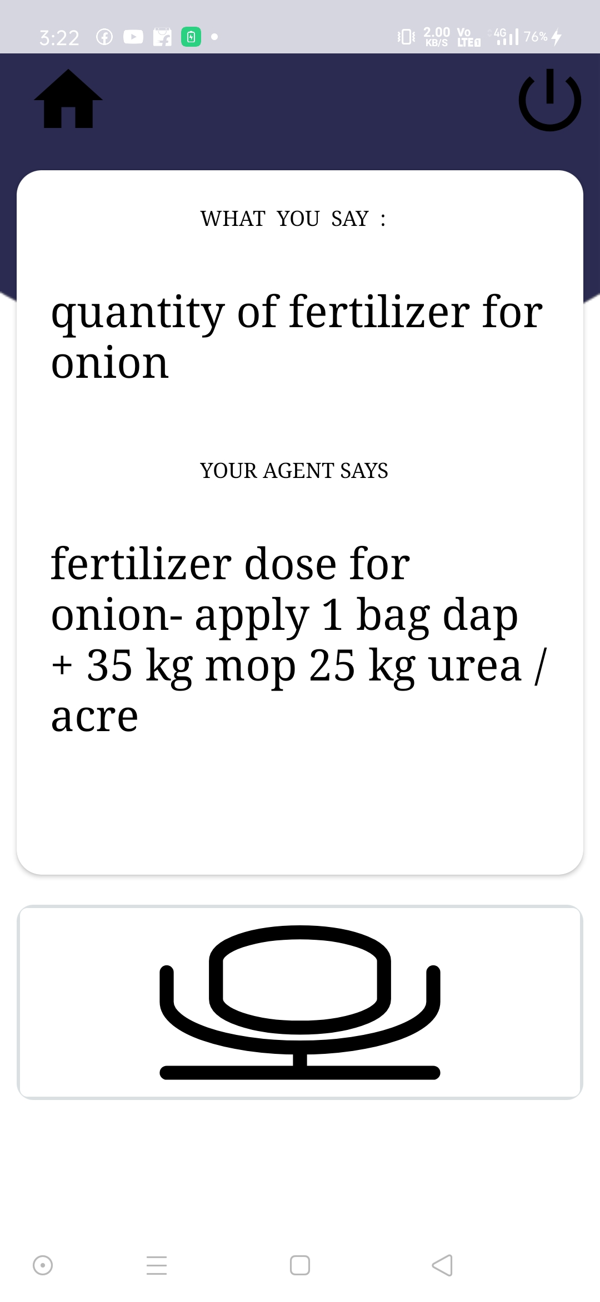
Voice Enabled Chatbot
Implemented Around 600 queries.
Works with any type of query related to farming.
Handy feature for those who face difficulty in typing on smartphone.

Slide 11
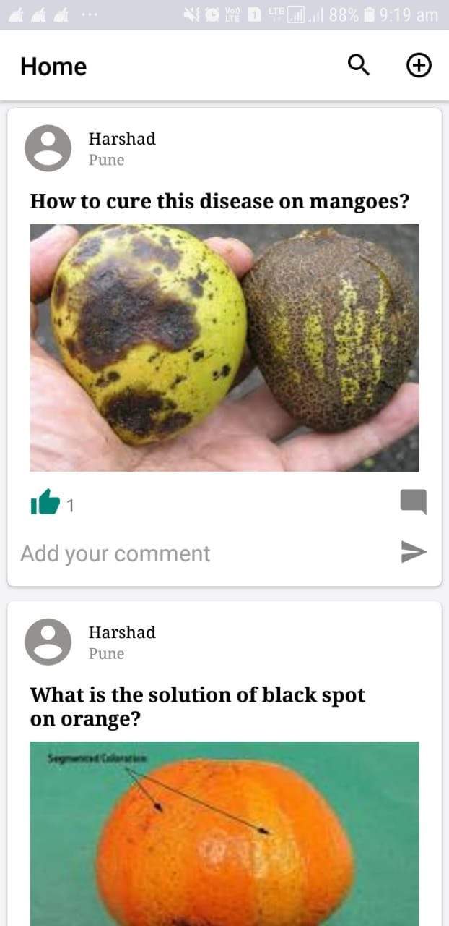
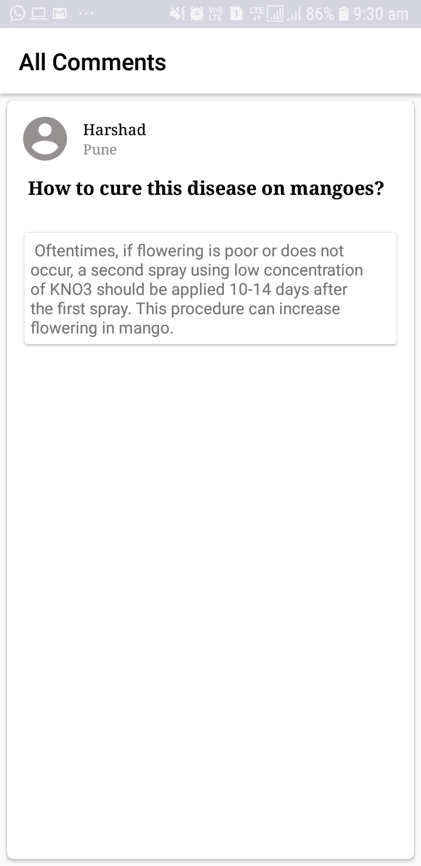
Open Forum
Here farmers upload any problems faced by them.
The solutions are provided from industry experts.
Farmers may even have discussion about the issue among each other.

Slide 12


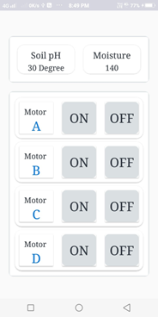
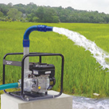
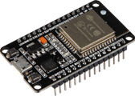
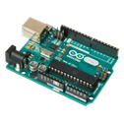
Smart Irrigation System
GET
POST
GET
POST
+
Soil Tension

Slide 13
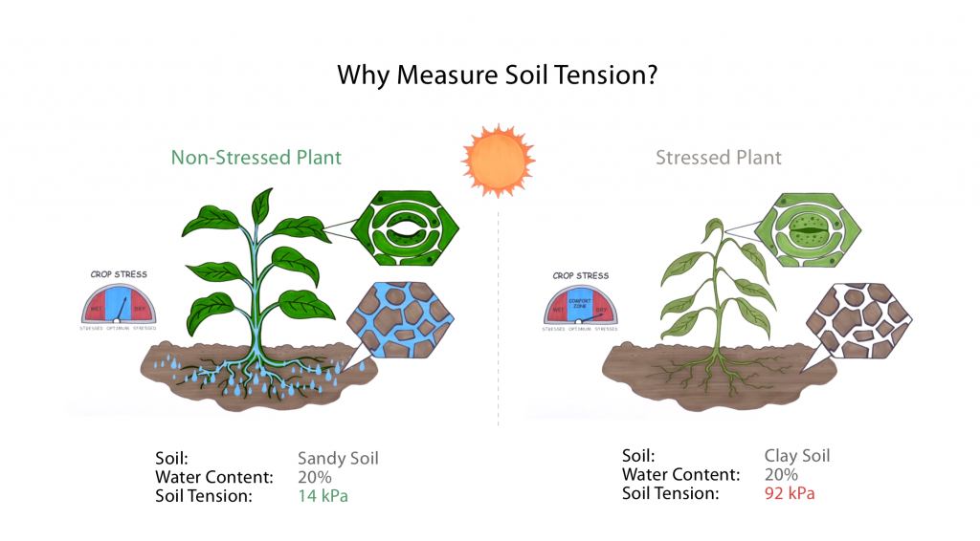

Slide 14
Why we different From others?
Accessibility
Availability
Security
Aadhar Authenticate
As our app is user friendly accessing it is very easy.
Most of the features are available offline.
Our app uses API so it is more secure.
Integration of Aadhar with App
Simplified UI/UX.
Faster response.
Light weighted app so supported by lwo specification mobiles.
Not much Internet connectivity necessary.
Servers are good.
Aadhar Authentication.
Database management through APIs.
Government schemes are directly notified on the basis aadhar.

Slide 15
Future Scope
Make App that works with Regional Languages.
Adding more Data for detection for wide range of disease detection.
Making AADHAR Card Authentication so Government Schemes can easily reachable to Farmers according to his needs.
ONE APP for FARMER so that everything comes under same hood.

